Slide 1
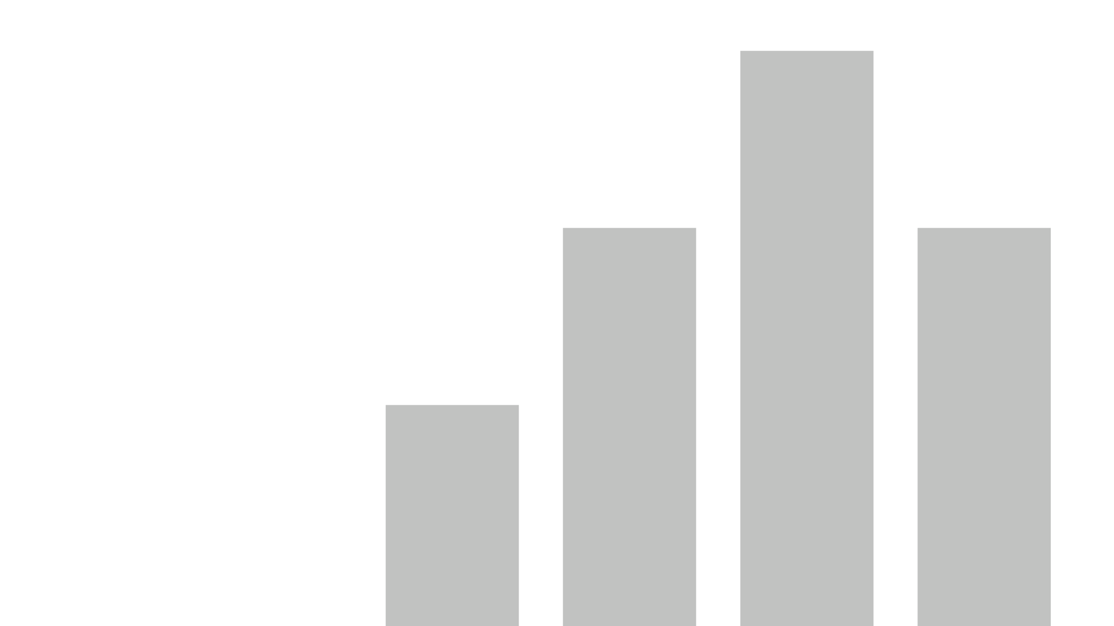


PYTHON DIWALI SALES
A Python Project on Festival sales across India
View in Power BI
Under the guidance of
Ms. MANALI PATIL
Email: manalivikas.patil@anudip.org
Sincerely,
M. MOHAMMAD SOHAIL
BATCH CODE: ANP-C7333, STUDENT ID : AF0367070
Last data refresh:
4/10/2024 9:13:24 PM UTC
Downloaded at:
4/11/2024 3:50:03 AM UTC

Slide 2
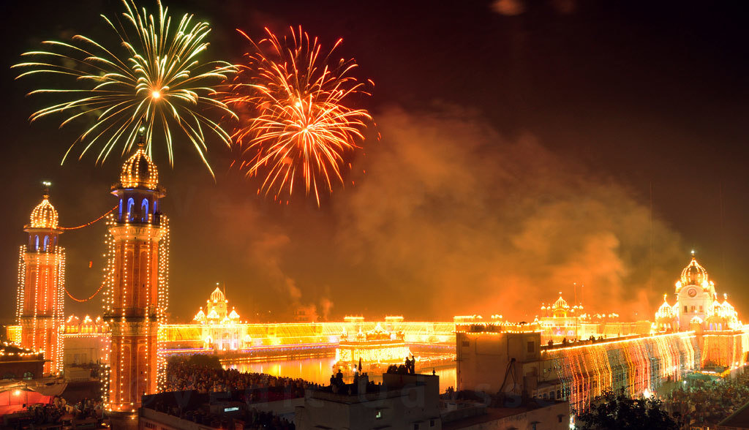
CHAPTER 1: INTRODUCTION
Brief introduction to Diwali festival
Diwali, also known as the Festival of Lights, is a significant Hindu festival celebrated with much fervor and joy, symbolizing the victory of light over darkness and good over evil. During Diwali, families come together to exchange gifts, light oil lamps, and fireworks, creating a vibrant
Importance of sales analysis during festive seasons
Festive Sales Analysis
Understanding Behavior
Optimizing Strategies

Slide 3
CHAPTER 2: PROJECT OVERVIEW
Planning and Requirements Definition
Development and Integration
Quality Assurance and Training
Project Overview:
The objective of this project is to conduct Diwali Sales Analysis using Python. It involves analyzing sales data to discover trends, improve customer experience, and boost revenue through optimized marketing strategies during the festive season.
Brief overview of steps involved:
Objective of the project
Sales analysis boosts forecasting, inventory, promotions.
Analyze Diwali sales data.
Analyzing Diwali sales for trends, preferences, improvement.
Tools and technologies used:
Python Development
Data Analysis

Slide 4


CHAPTER 3: DATA COLLECTION
Source of data (e.g., sales database, CSV file)
The datasets for this project are collected from GitHub and Kaggle, primarily sourced from a sales database. CSV files supplement the data, containing relevant information like date, product details, quantity sold, and price, crucial for analysis and insights.
Explanation of data fields
Challenges: Data quality.
Concern: Data integrity.
Strategy: Mitigation and resolution.

Slide 5


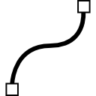

.
CHAPTER 4: DATA PRE-PROCESSING
Data Understanding
Transformation/Engineering
Analysis/Insights
Data cleaning involves
Handling missing values.
Removing duplicates.
Formatting data types
Date string to datetime.
Standardize: Data types.
Enhance: Format for analysis.

Slide 6
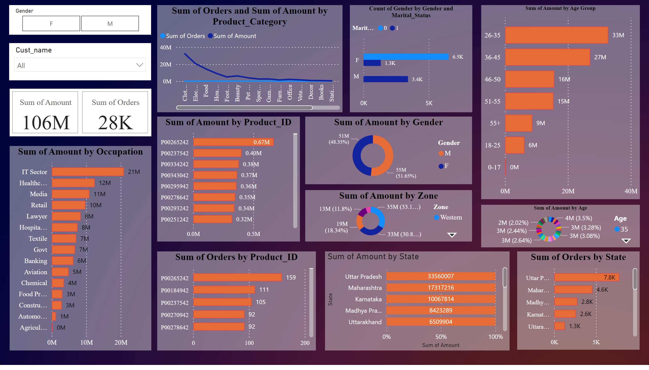
Page 1
CHAPTER 5: EXPLORATORY DATA ANALYSIS
Notes:
barChart
No alt text provided
barChart
No alt text provided
clusteredBarChart
No alt text provided
clusteredBarChart
No alt text provided
lineChart
No alt text provided
donutChart
No alt text provided
cardVisual
No alt text provided
donutChart
No alt text provided
clusteredBarChart
No alt text provided
slicer
No alt text provided
slicer
No alt text provided
clusteredBarChart
No alt text provided
donutChart
No alt text provided
hundredPercentStackedBarChart
No alt text provided

Slide 7
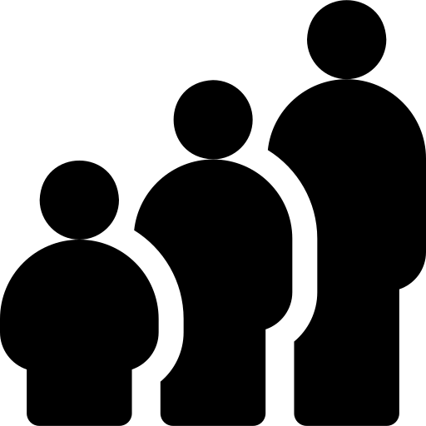


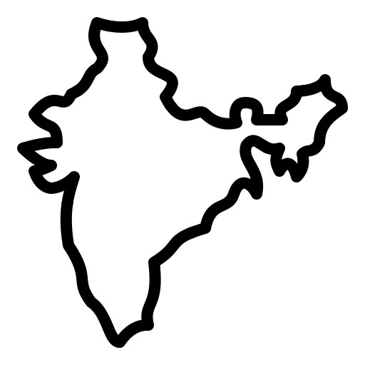

CHAPTER 6:
CUSTOMER SEGMENTATIONS
AGE
SUM OF AMOUNT BY AGE GROUP
SUM OF AMOUNT BY AGE
AMOUNT
SUM OF AMOUNT BY OCCUPATION
GENDER
COUNT OF GENDER AND MARITAL STATUS
SUM OF AMOUNT BY GENDER
STATE
SUM OF ORDERS BY STATE
SUM OF AMOUNT BY STATE
PRODUCT CATEGORY
SUM OF AMOUNT BY PRODUCT CATEGORY & ID
SUM OF ORDERS BY PRODUCT CATEGORY & ID
ZONE
SUM OF AMOUNT BY STATE

Slide 8
CHAPTER 7
SALES PREDICTION
GENGER & MARTIAL STATUS
AGE GROUP
AGE
HIGH
LOW
MALE - 55M (51.65%)
FEMALE - 51M (48.35%)
26 – 35
0 - 17
35
12
OCCUPATION
PRODUCT ID
ORDERS
HIGH
LOW
IT SECTOR
AGRICULTURE
P00265242
P00312942
159
1
SALES CATEGORY
AMOUNT
STATE
HIGH
LOW
CLOTHING [32199912]
HAND & POWER TOOLS [133950]
21 M
0M
UTTAR PRADESH
GUJRATH

Slide 9
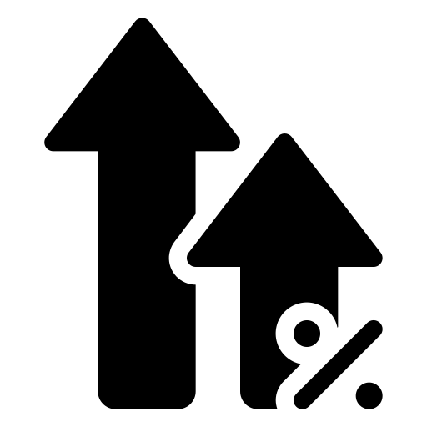

CHAPTER 8: RECOMMENDATIONS
INVESTS
INVESTS
NEGLECTATION
DISREGARD
CATEGORIES
CLOTHING & APPERAL
FOOD
ELECTROICS
ZONE - WESTERN
STATE
MAHARASTHA
JHARKHAND
RAJASTAN
GENDER - UN-MARRIED MALE
OCCUPATION - IT
CATEGORIES
AUTO
TUPPERWARE
HAND & POWER TOOLS
ZONE - NORTHERN
STATE
GUJARATH
BIHAR
TELANGANA
GENDER - MARRIED FEMALE
OCCUPATION - AGRICULTURE

Slide 10

CHAPTER 9: CONCLUSION
Married women age group 26-35 yrs. from UP, Maharashtra and Karnataka working in IT, Healthcare and Aviation are more likely to buy products from Food, Clothing and Electronics category
LINK
GitHub: https://github.com/rishabhnmishra/Python_Diwali_Sales_Analysis

